Slide 1
MPhys Project assessment briefing
R F L Evans

Slide 2
Summary of MPhys Project Assessments and timeline
Assessment | Weighting (%)
Project notebook, Term 1 | 5
Project notebook and overall progress | 25
Dissertation | 40
VIVA examination | 25
Conference poster | 5
Week
1
2
3
4
5
6
7
8
9
10
Project dissertation
draft to supervisor
Project report feedback
Project VIVAs
Project conduct form
Project dissertation and notebook
Project poster

Slide 3
General points
Detailed deadlines available from the assessment calendar
https://wiki.york.ac.uk/display/Physics/Year+4?preview=/131304531/278006232/2021_22%20Year%204%20Term%203%20Assessment%20Calendar.pdf
Check the proforma on the VLE for each assessment to see what is expected
https://vle.york.ac.uk/webapps/blackboard/content/listContentEditable.jsp?content_id=_4191917_1&course_id=_101549_1

Slide 4
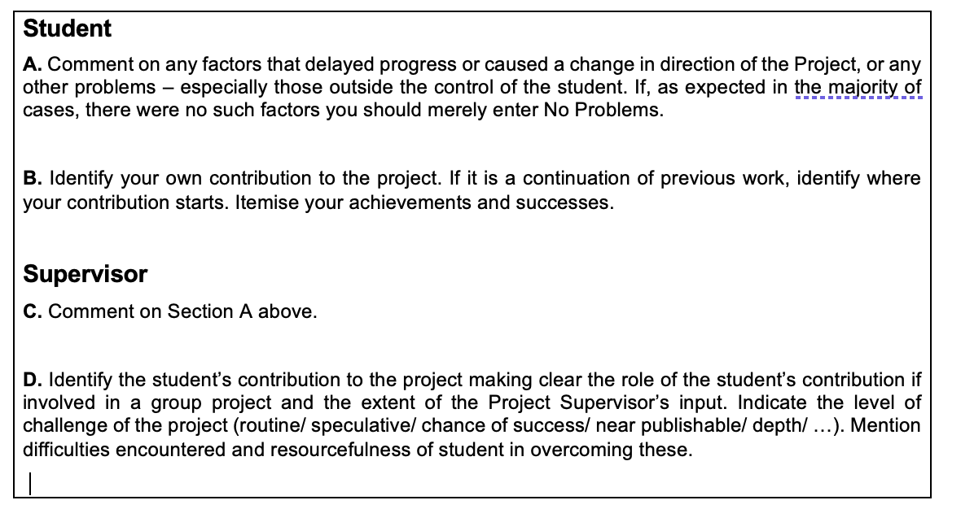
Project conduct report form
The project conduct form is where you may outline any external factors that affected your project progress
You also detail your specific individual contribution to the project
The supervisor also comments on these factors and your specific contribution to the project

Slide 5
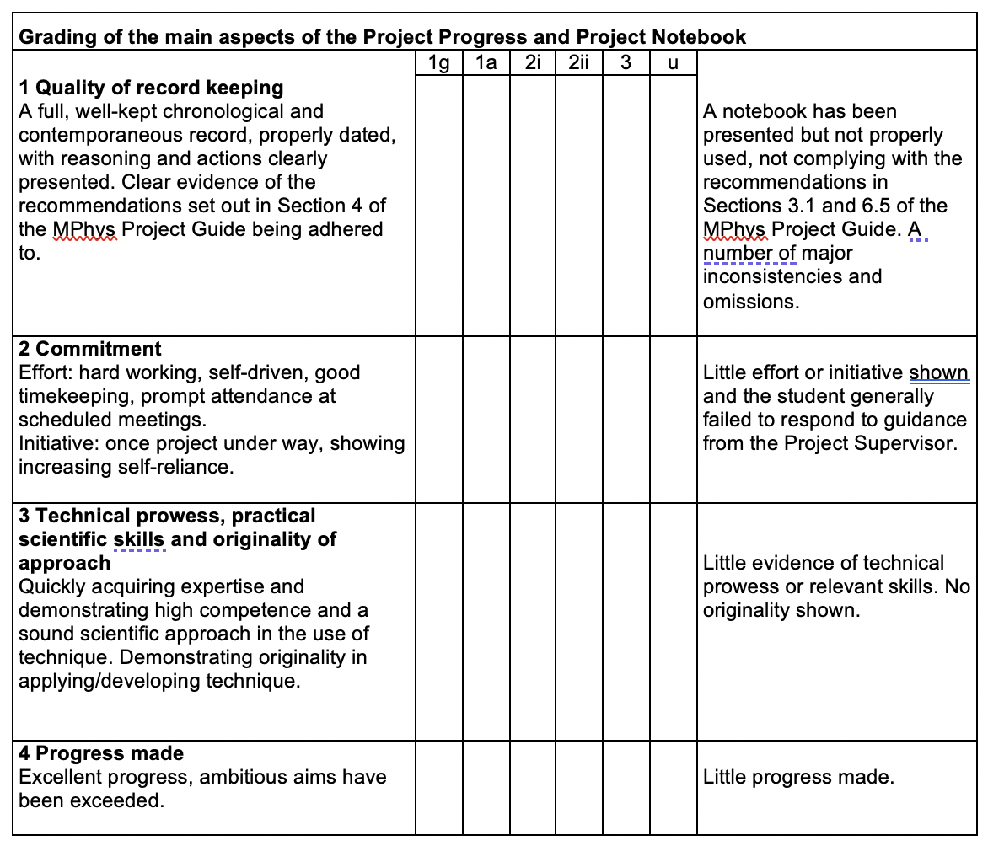
Project progress and notebook
25% of the total mark
Partially the project notebook in the second/third terms
Overall commitment, skills and progress throughout the project

Slide 6
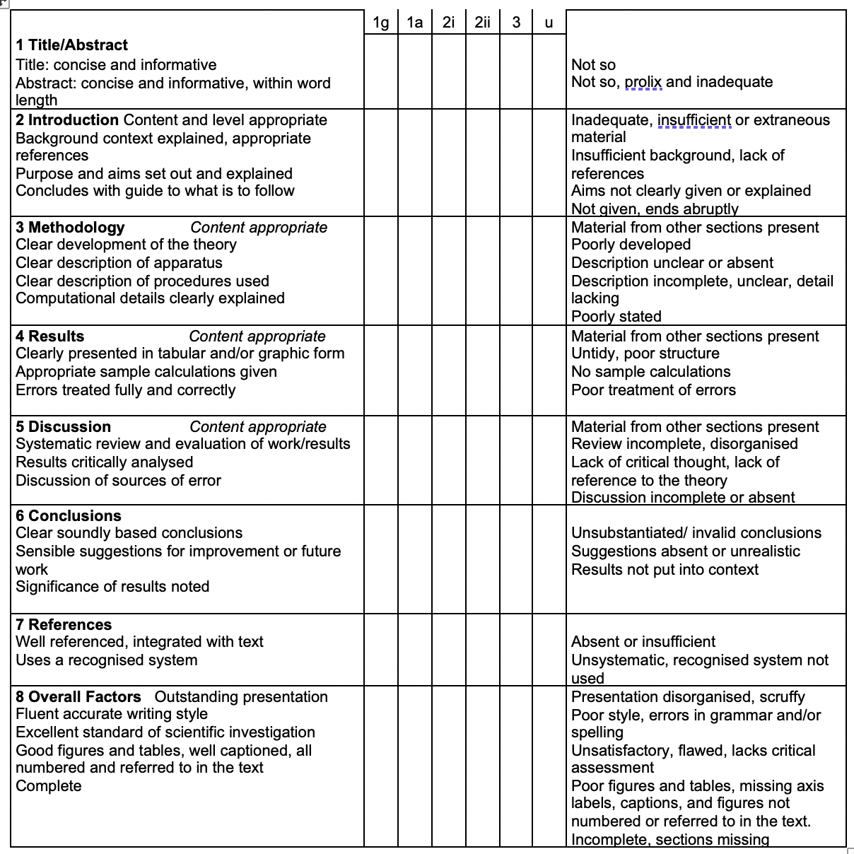
Project dissertation
40% of the total mark
Follow the guidelines given in the proforma
Ideally try and match all the criteria on the left hand side
Maximum 8 000 words (10 000 Physics and Philosophy)
Abstract, figure captions, equations, references and appendices are NOT included in the word count

Slide 7
Remember the Funnel Timeline!
Motivation
Research Question
Methodology
Results
Time
Discussion
Conclusion
Breadth

Slide 8
Dissertation draft
Please submit a draft dissertation to your supervisor by Wednesday Week 1
Supervisors will provide feedback on clarity, presentation, writing style and scientific communication
Supervisors cannot edit your dissertation, either by adding or correcting text, correcting equations or captions
Feedback in week 3 to allow time to implement changes
If using Google Docs or Overleaf considering sharing the document with the supervisor to provide live feedback on the most up to date draft

Slide 9
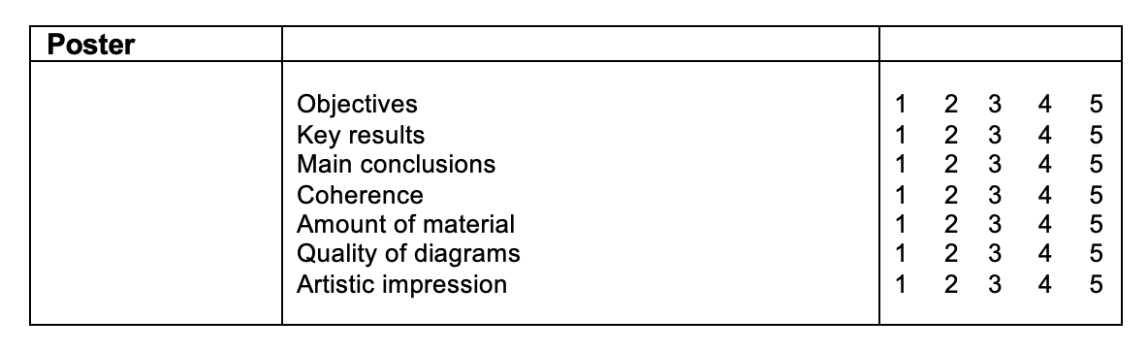
Project Poster
5% of the total mark
A scientific presentation of the highlights of your work (1-4 figures): tell your project story
Presentation is important - colour schemes, high quality figures!

Slide 10
Project VIVA
25% of the total mark
Around 30-40 minute long oral examination with two examiners, one expert and one general
A short presentation of the highlights of your project 5-10 minutes long. Use visual aids where appropriate
20-30 minutes of detailed questions on any aspect of your project
You may refer to a copy of your dissertation in the examination
Examiners will assess your physics knowledge and understanding of your dissertation and results

Slide 11
Questions?

